Slide 1


A Trial design in experiment 1
50ms
200ms
1.5s to 2s
B Trial design in experiment 2
50ms
200ms
2.3s to 2.5s
C Trial design in experiment 3
150ms
210ms
1.5s to 2s
Figure 1. Illustrations of examples of trials for three experiments. The upper panel (A) illustrates each trial in experiment 1 is either a 4-sound sequence which consists of four tones of 50ms long with gaps of 200ms between each tone, or a 3-sound sequence which contains three 50-ms long tones with 200ms long gaps. Intervals between trials are random selected between 1.5 second to 2 second. The middle panel (B) illustrates trials in experiment 2 are same as that of experiment 1, except the intervals between trials are ranging from 2.3s to 2.5s. The bottom panel (C) illustrate each trial in experiment 3 is either a 4-tactile-stimulus sequence which consists of four tactile stimuli of 210ms long with gaps of 210ms between each tactile stimulus, or a 3-tactile-stimulus sequence which contains three 150-ms long tones with 210ms long gaps. Intervals between trials vary between 1.5 second to 2 second.

Slide 2
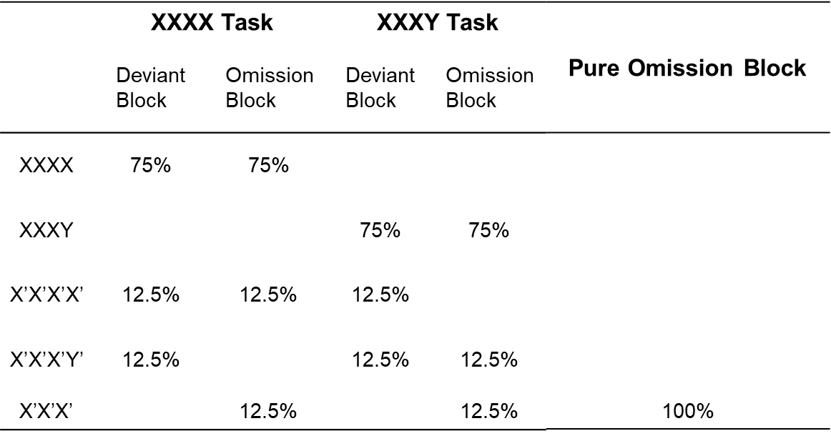
Figure 2. Illustrations of Block design of three experiments. Three experiments involve both XXXX and XXXY task which are consisted of three types of trials in each block. XXXX task with deviant block is consisted of 75% standard trials (XXXX), 12.5% new frequency trials (X’X’X’X’ and 12.5% rule deviant trials (X’X’X’Y’); XXXX task with omission block is consisted of 75% standard trials (XXXX), 12.5% new frequency trials (X’X’X’X’ and 12.5% omission X trials (X’X’X’). In contrast, XXXY task with deviant block involves 75% standard trials (XXXY), 12.5% new frequency trials (X’X’X’Y’ and 12.5% rule deviant trials (X’X’X’X’); XXXX task with omission block involves 75% standard trials (XXXY), 12.5% new frequency trials (X’X’X’Y’) and 12.5% omission Y trials (X’X’X’). Pure omission block consists of 100% purely omission trials (XXX), which following deviant block in XXXX task or XXXY task only in experiment 2. The orthogonal design of these experiments enable two level of regularities, standard versus deviant and local versus global.

Slide 3
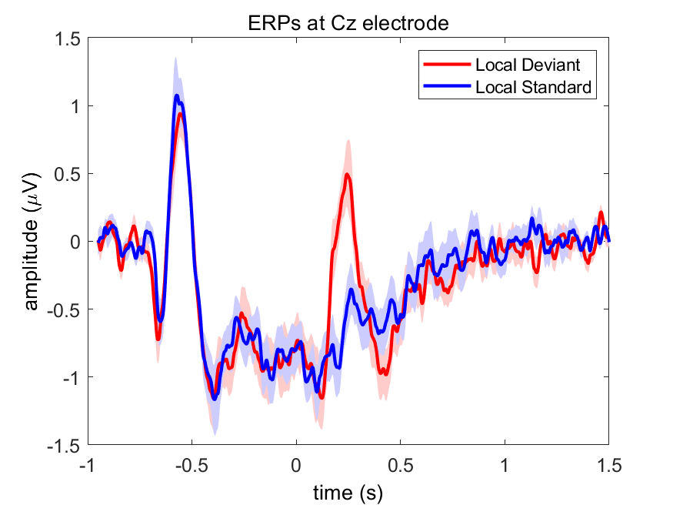
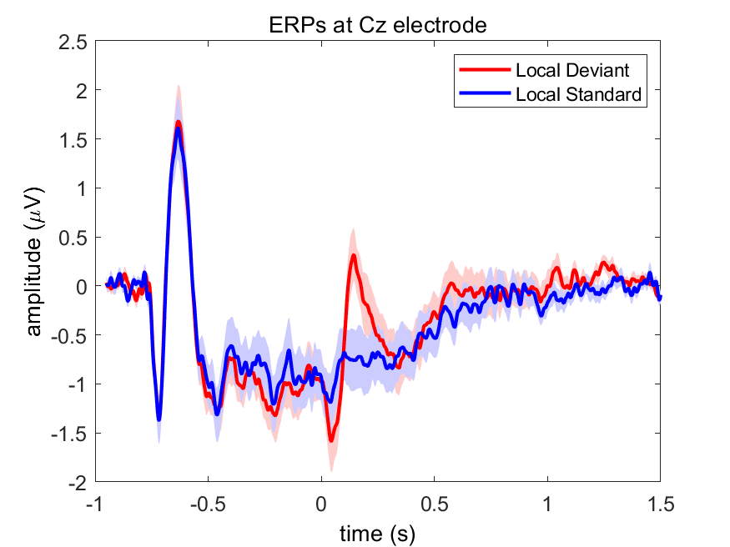
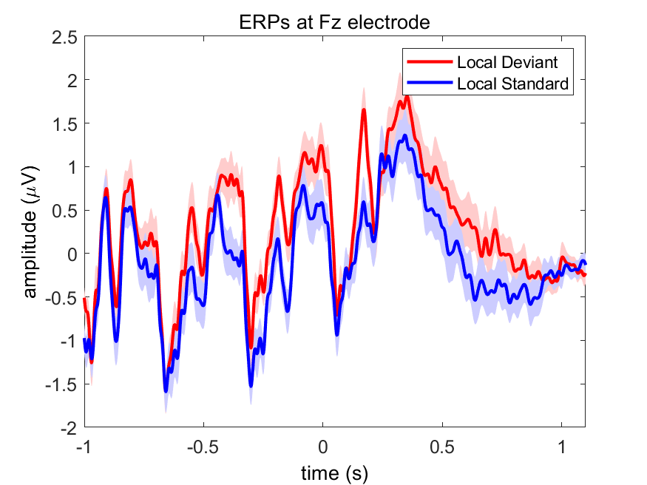
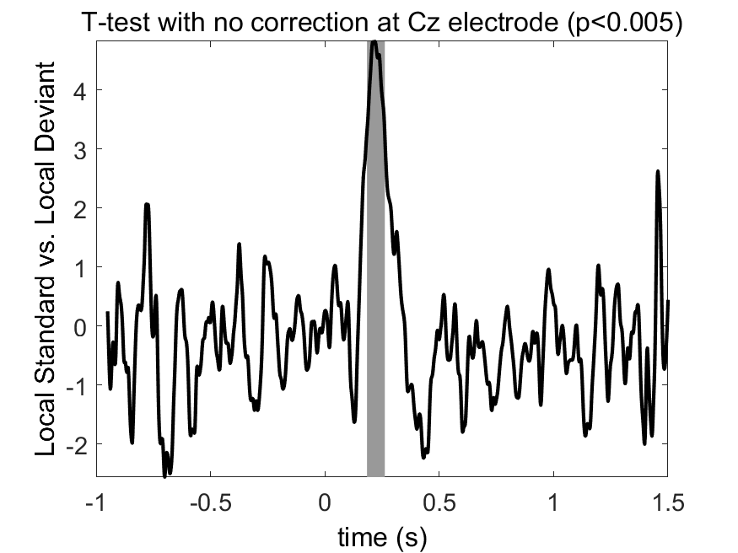
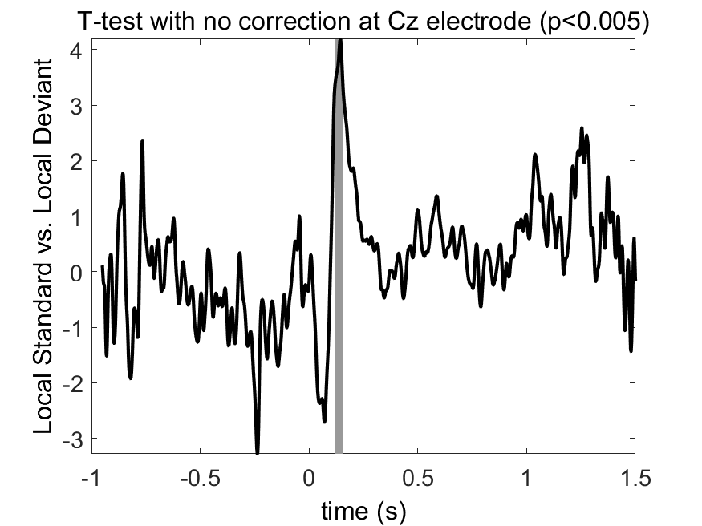
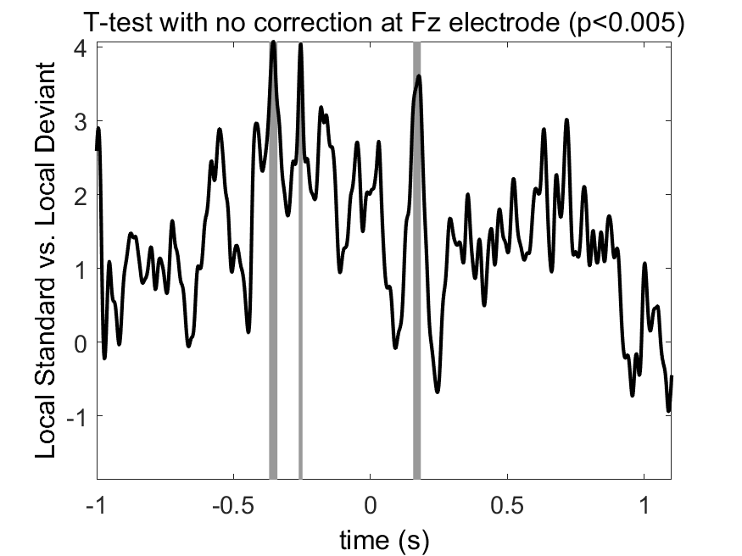
A
C
E
B
D
F
A
Figure 3. Grand-averaged ERPs elicited by local deviant (red) and local standard (blue) condition in three experiments. The upper left panel (A): Local deviant trials elicit mismatch negativity (MMN) response compared local standard trials at Cz electrode in experiment 1. Gray-shaded area in the bottom left panel (B) indicates statistically significant time window (190-250ms) for this MMN response; The upper middle panel (C): MMN response at Cz electrode elicited by local effect in experiment 2. The bottom middle panel (D) indicates statistically significant time window for this MMN response is between 100-150ms; The upper right panel (E): MMN response at Fz electrode elicited by local effect in experiment 3. The bottom right panel (F) indicates statistically significant time window for this MMN response is between 150-190ms. Statistical difference between local deviant and local standard condition is calculated by paired t-test (P<0.005).

Slide 4
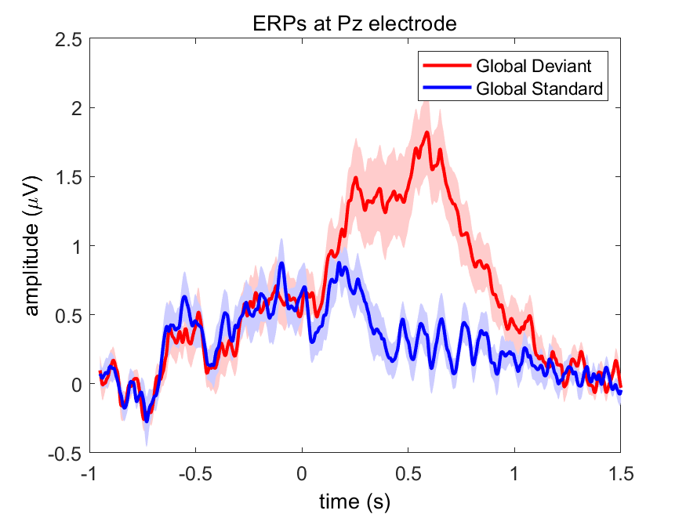
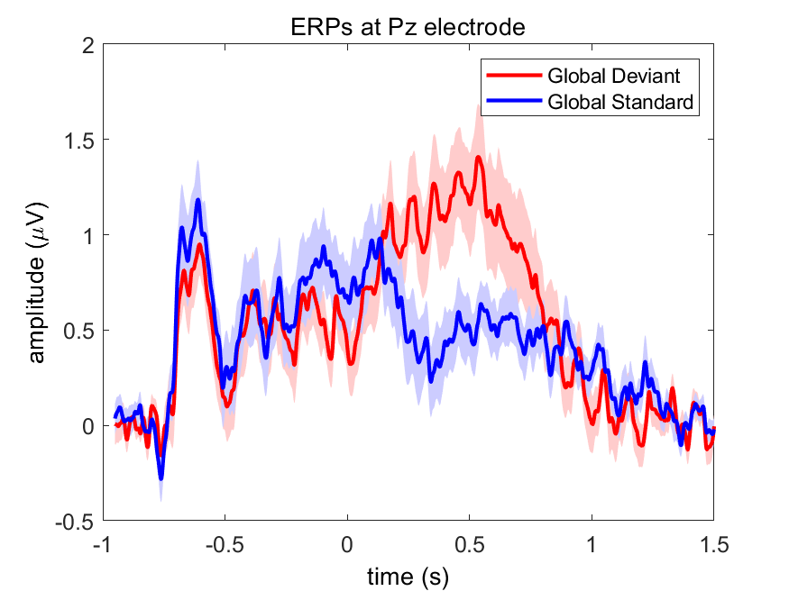
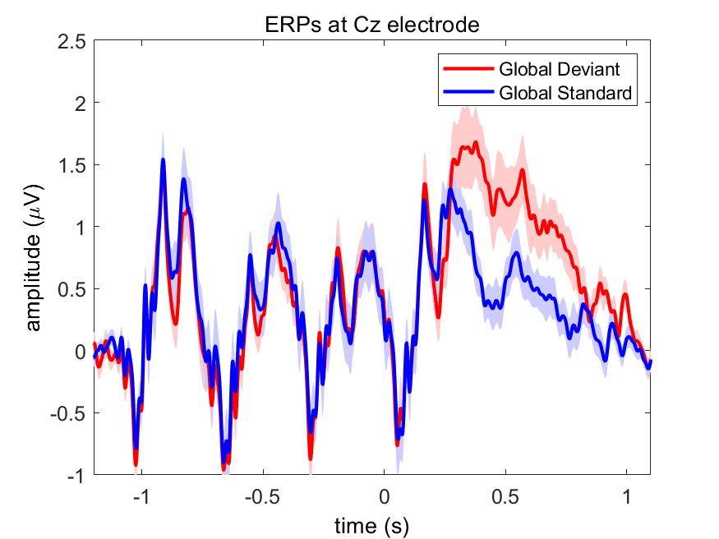
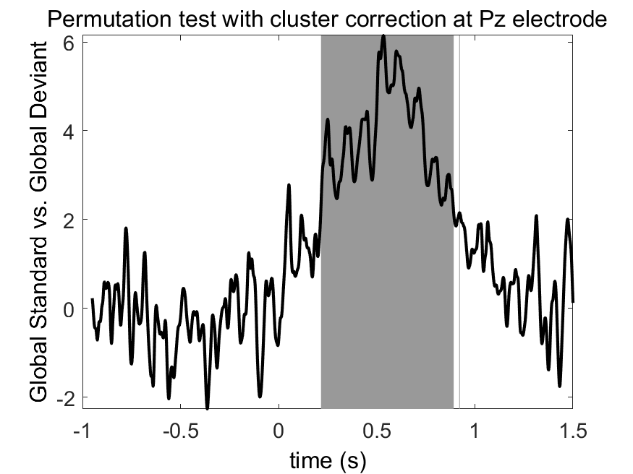
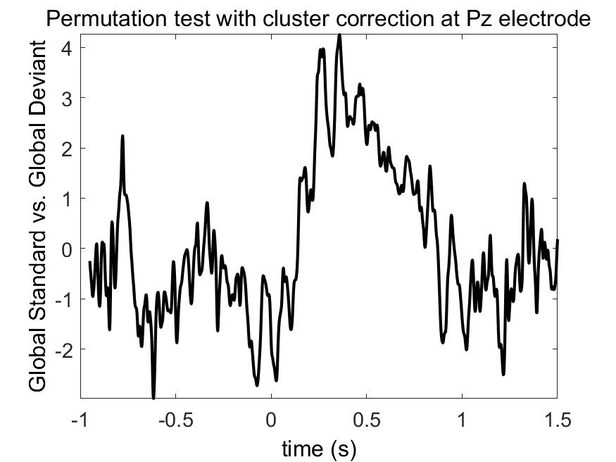
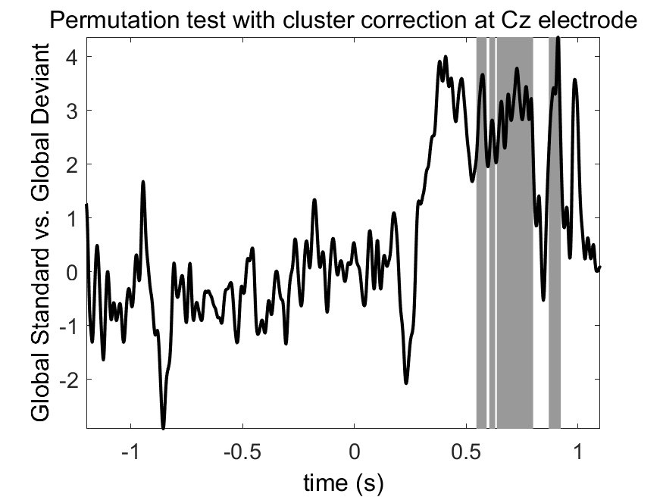
A
C
E
B
D
F
Figure 4. Grand-averaged ERPs elicited by global deviant (red) and global standard (blue) condition in three experiments. The upper left panel (A): Global deviant trials elicit P3b response compared global standard trials at Pz electrode in experiment 1. Gray-shaded area in the bottom left panel (B) indicates statistically significant time window (220-900ms) for this P3b response; The upper middle panel (C): P3b response at Pz electrode elicited by global effect in experiment 2. The bottom middle panel (D) indicates no statistically significant time window for this P3b response due to limited number of participants, but we can observe obvious P3b response ranging from 240ms to 650ms; The upper right panel (E): P3b response at Cz electrode elicited by global effect in experiment 3. The bottom right panel (F) indicates statistically significant time window for this P3b response is between 550-900ms. Statistical difference between global deviant and global standard condition is calculated by the cluster-based permutation test (P<0.05).

Slide 5
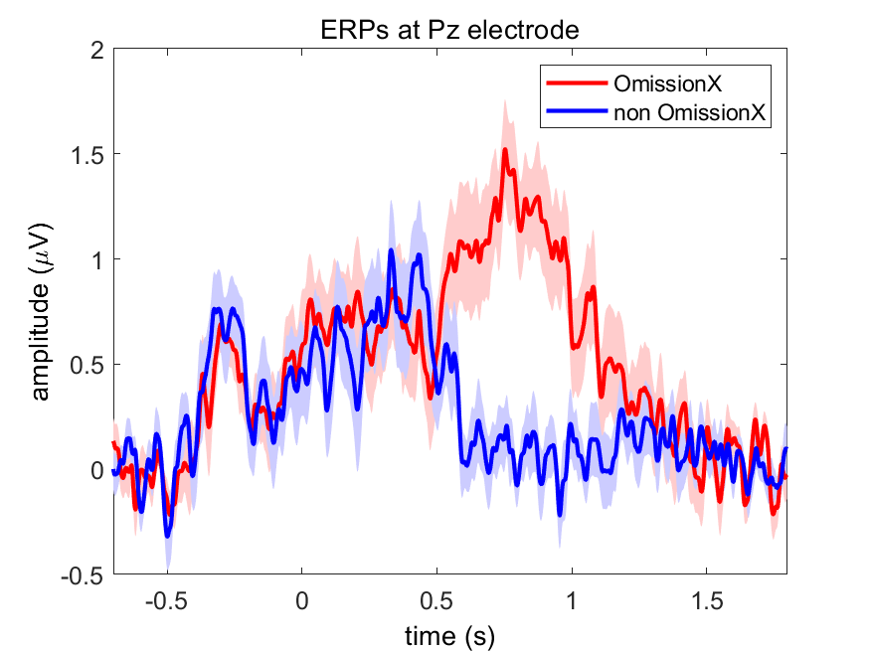
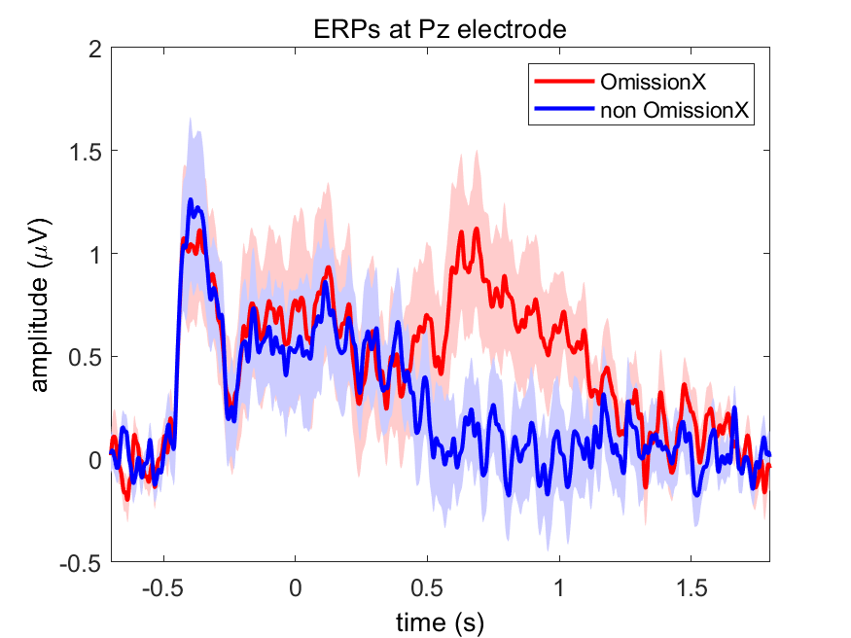
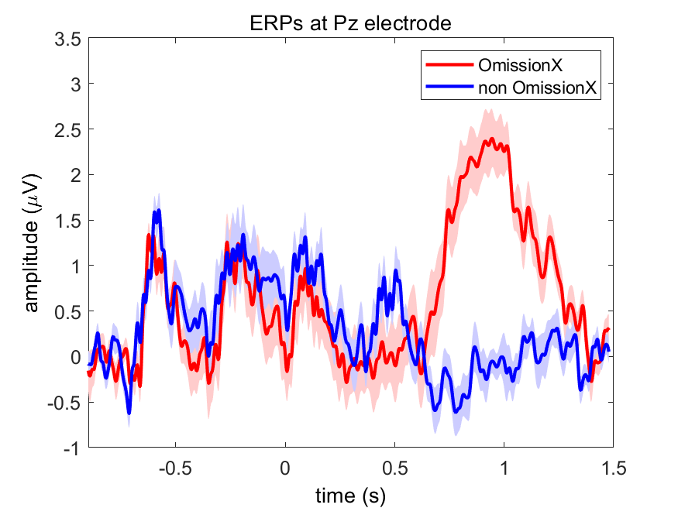
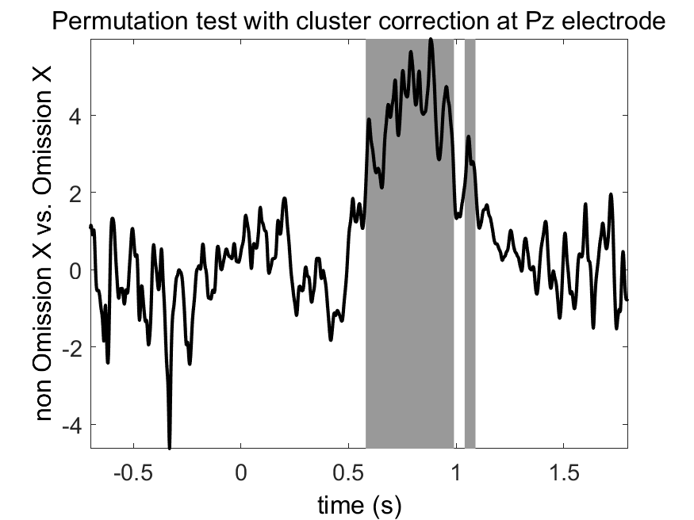
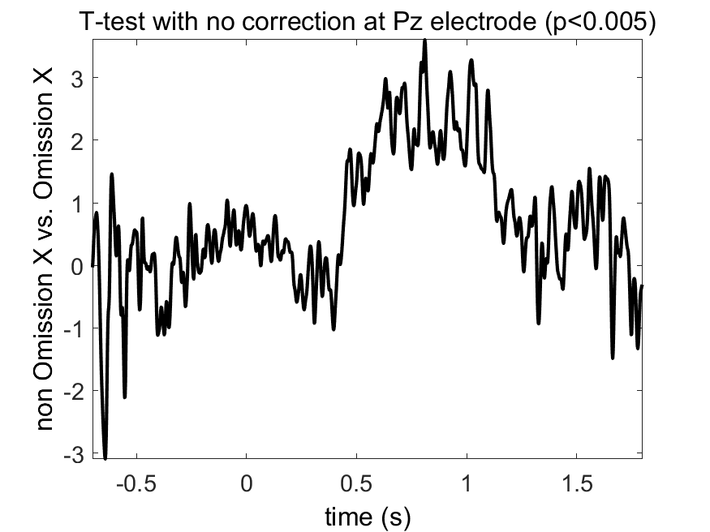
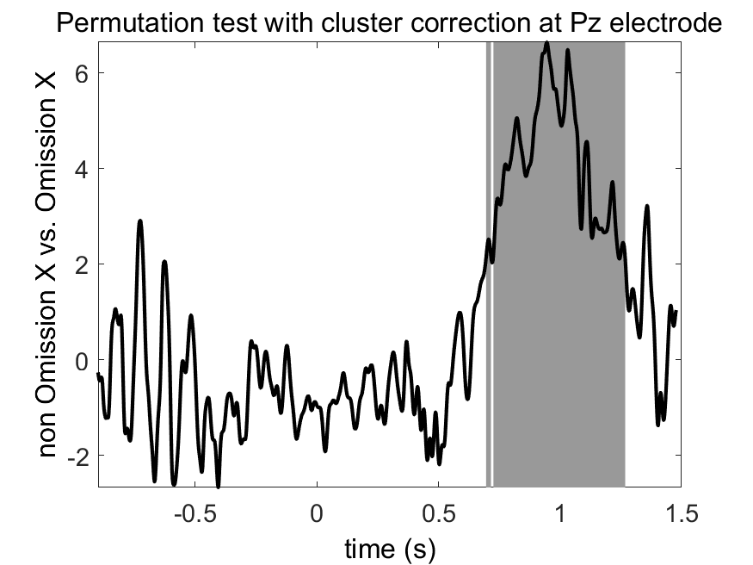
A
C
E
B
D
F
Figure 5. Grand-averaged ERPs elicited by omission X (red) and non-omission X (blue) condition in three experiments. The upper left panel (A): Omission X trials elicit P3b response compared non-omission X trials at Pz electrode in experiment 1. Gray-shaded area in the bottom left panel (B) indicates statistically significant time window (600-1000ms) for this P3b response; The upper middle panel (C): P3b response at Pz electrode elicited by omission X effect in experiment 2. The bottom middle panel (D) indicates no statistically significant time window for this P3b response due to limited number of participants, but we can observe obvious P3b response ranging from 600ms to 1000ms; The upper right panel (E): P3b response at Pz electrode elicited by omission X effect in experiment 3. The bottom right panel (F) indicates statistically significant time window for this P3b response is between 700-1300ms. Statistical difference between omission X and non-omission X condition is calculated by the cluster-based permutation test (P<0.05).

Slide 6
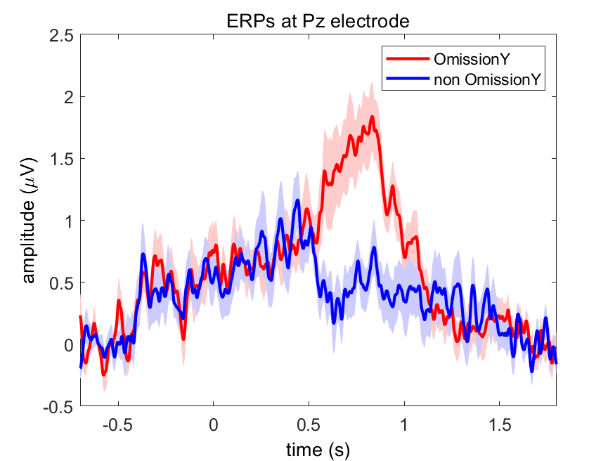
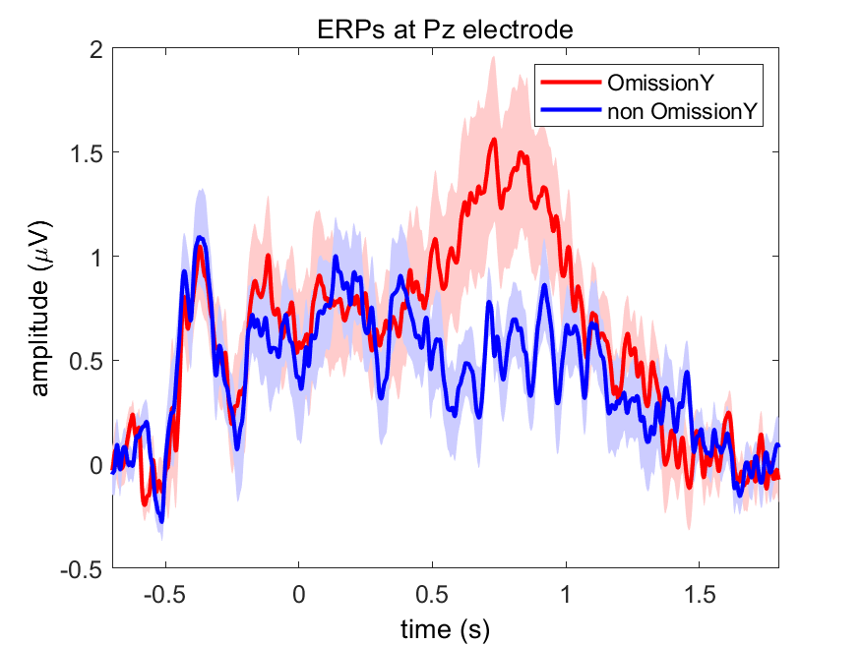
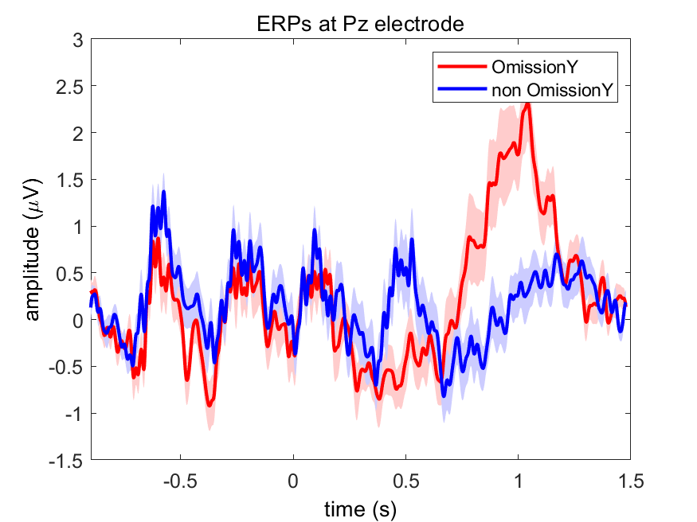
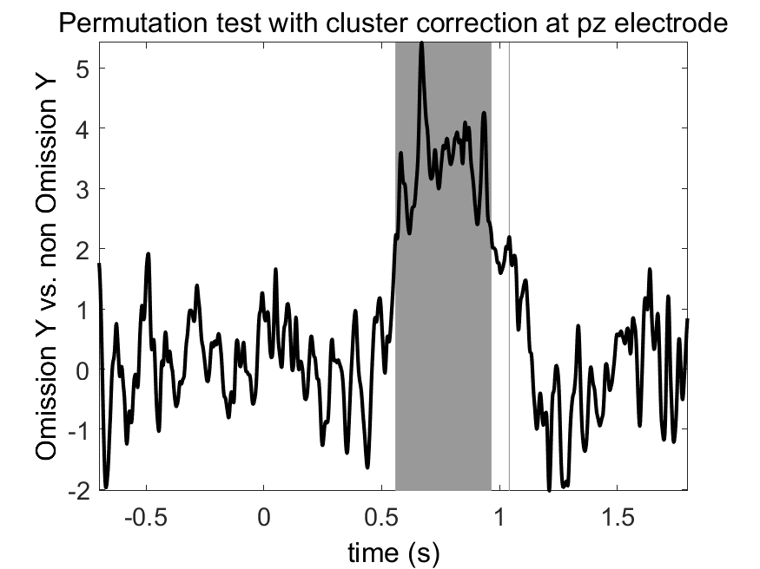
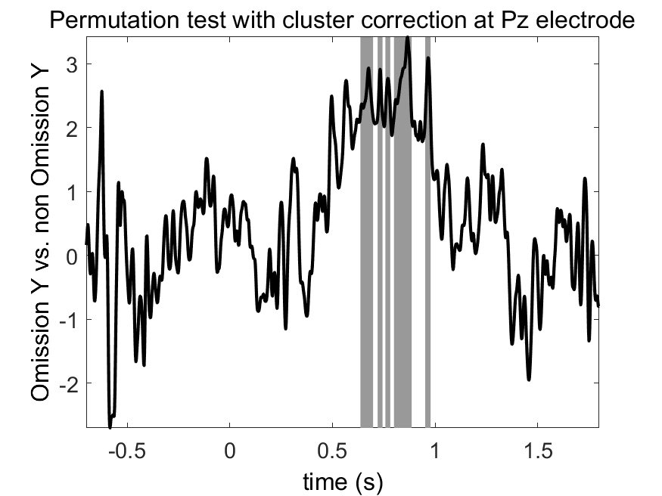
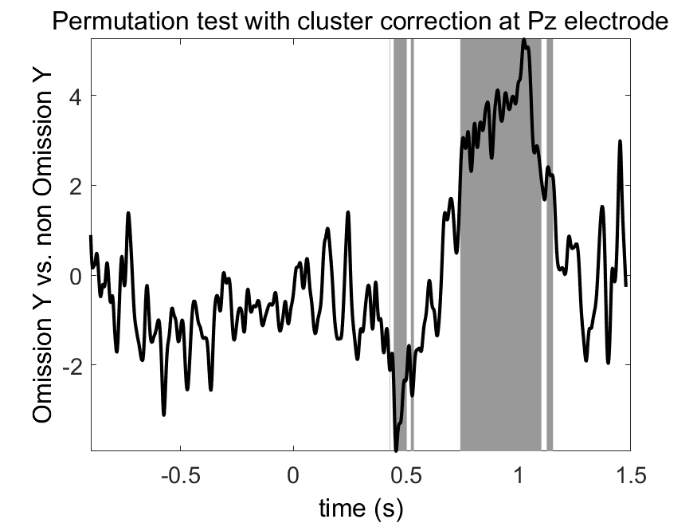
A
C
E
B
D
F
Figure 6. Grand-averaged ERPs elicited by omission Y (red) and non-omission Y (blue) condition in three experiments. The upper left panel (A): Omission Y trials elicit P3b response compared non-omission Y trials at Pz electrode in experiment 1. Gray-shaded area in the bottom left panel (B) indicates statistically significant time window (550-1000ms) for this P3b response; The upper middle panel (C): P3b response at Pz electrode elicited by omission Y effect in experiment 2. The bottom middle panel (D) indicates statistically significant time window for this P3b response ranges from 650ms to 1000ms; The upper right panel (E): P3b response at Pz electrode elicited by omission Y effect in experiment 3. The bottom right panel (F) indicates statistically significant time window for this P3b response is between 750-1100ms. Statistical difference between omission Y and non-omission Y condition is calculated by the cluster-based permutation test (P<0.05).

Slide 7
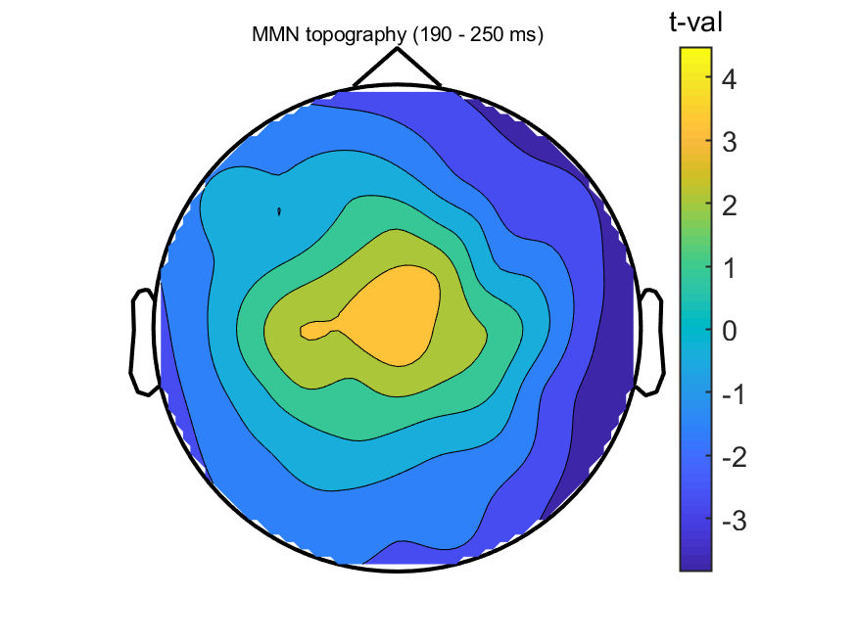
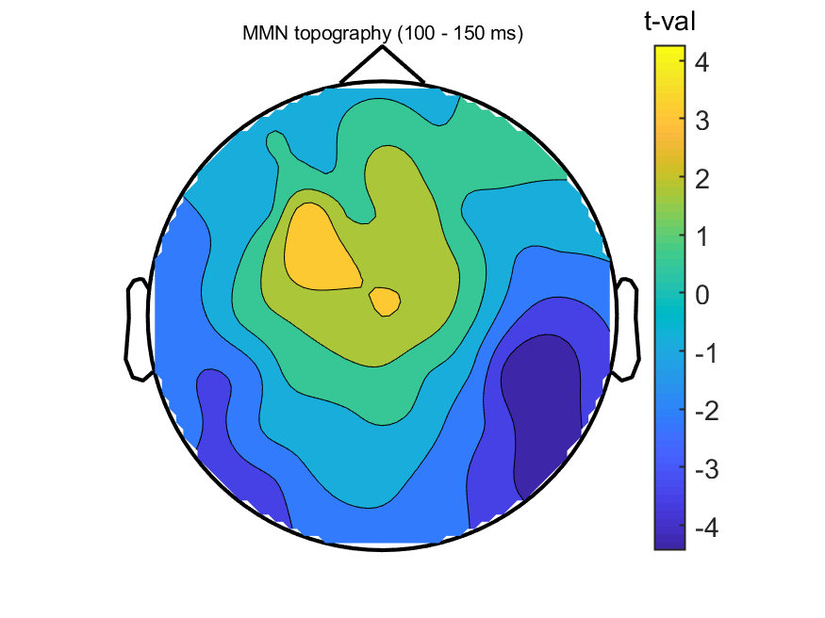
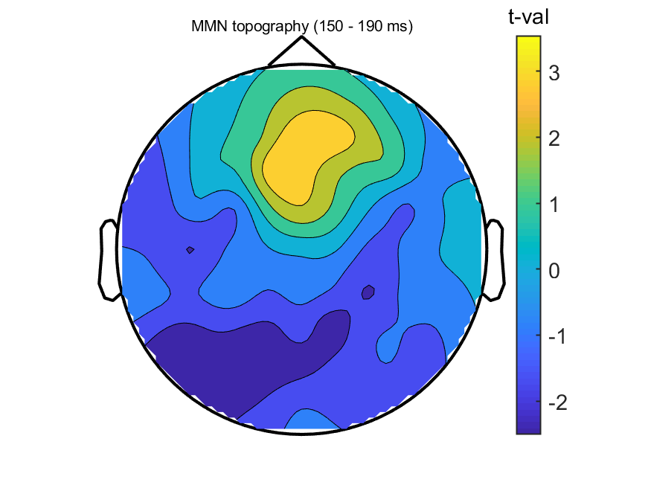
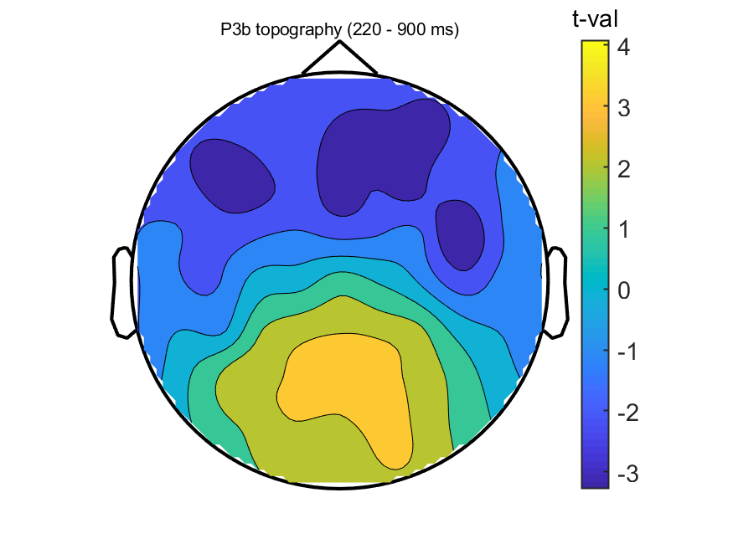
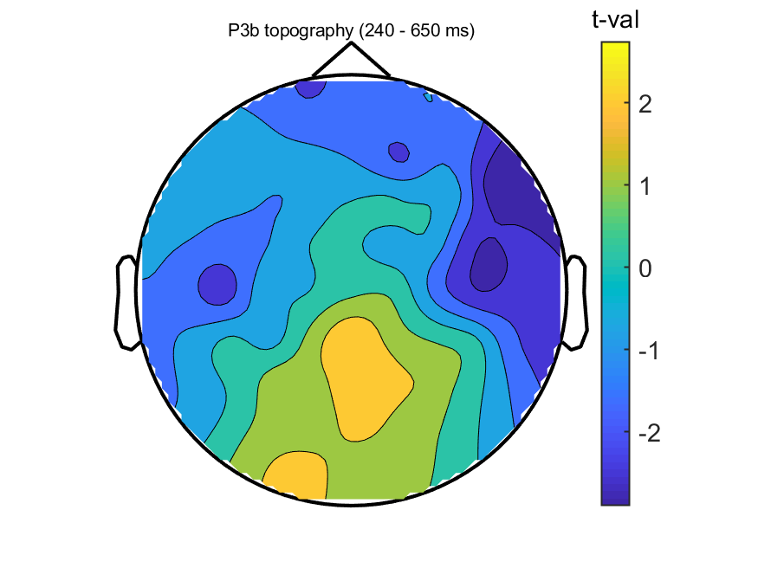
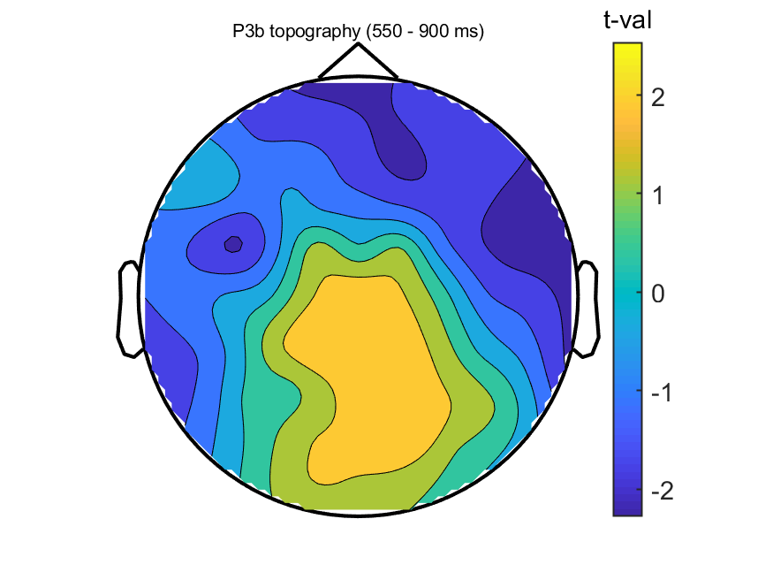
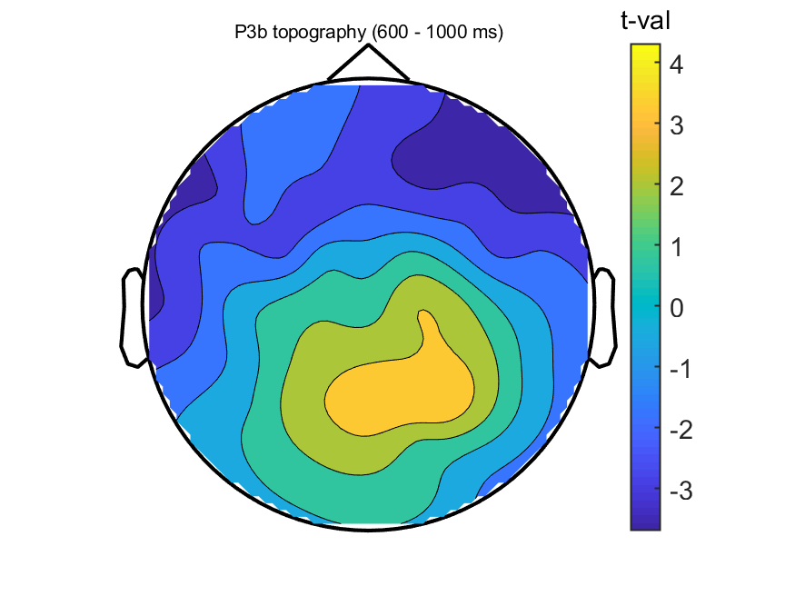
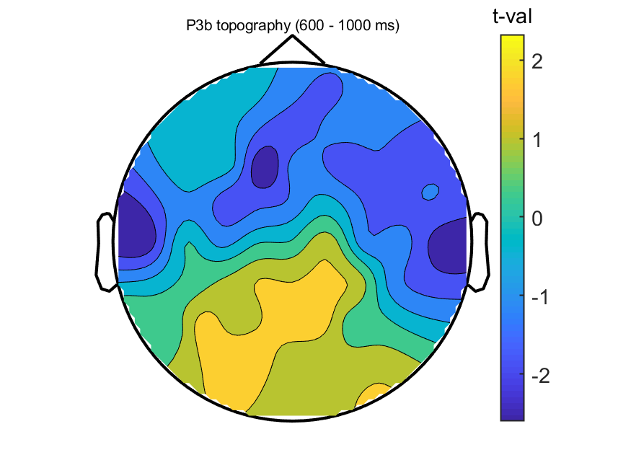
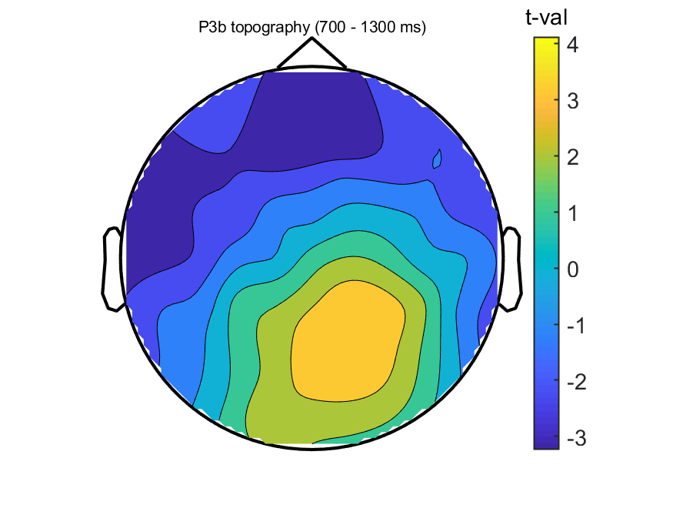
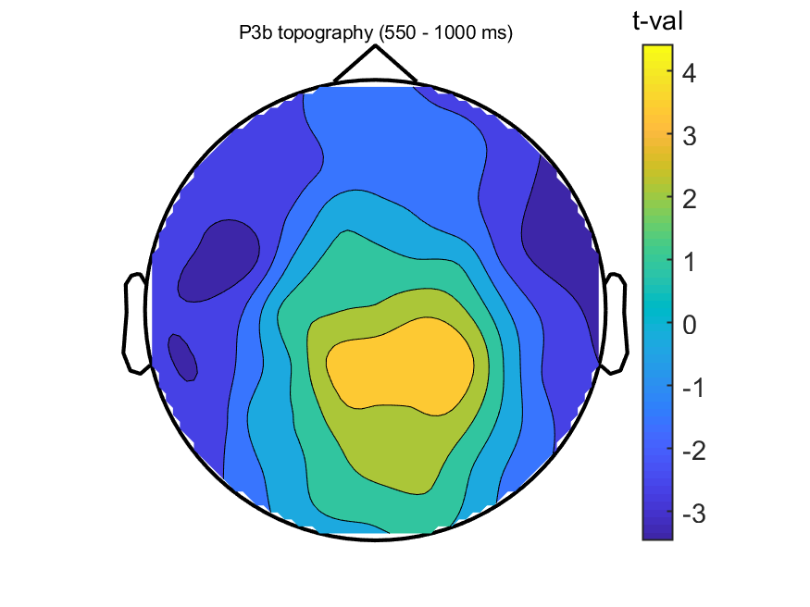
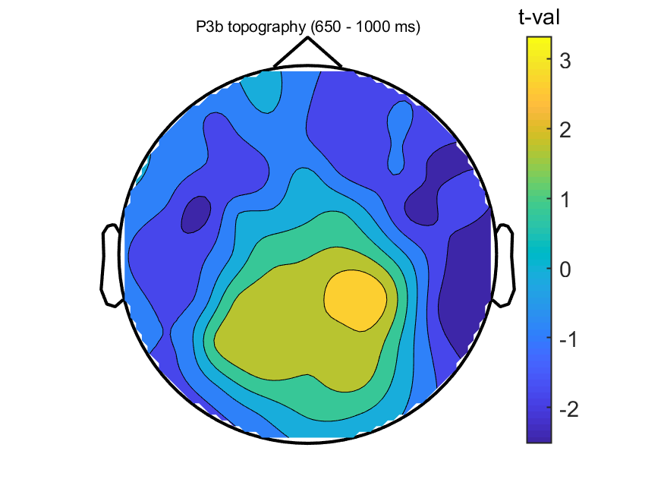
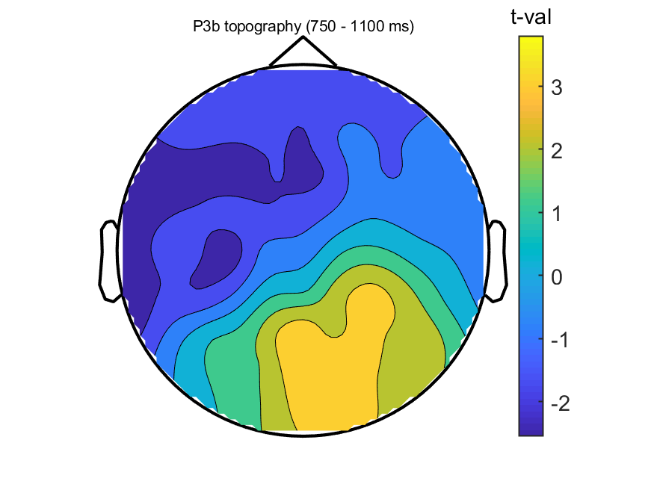
Exp. 1
Exp. 2
Exp. 3
Figure 7. Topography of t values for four condition comparisons in three experiments within significant time windows. MMN component caused by auditory modality dominant in central region. In contrast, MMN component elicited by tactile modality dominant in frontal region. P3b component reaches maximum in central-parietal area.
Local effect
Global effect
Omission X effect
Omission Y effect

Slide 8
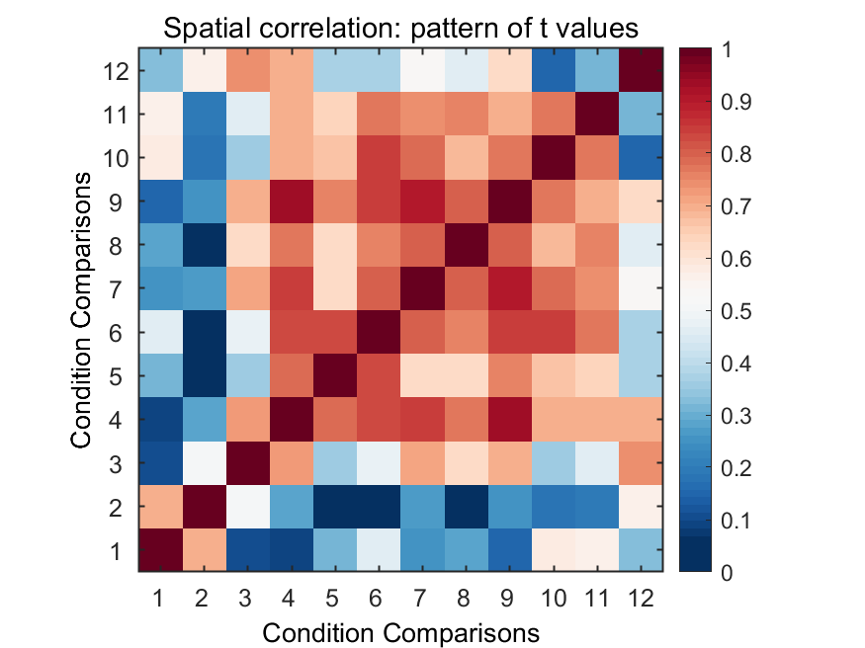
Figure 8. Spatial correlation matrix of t values for four condition comparisons across three experiments. Conditions (1-3) correspond to local comparison in experiment 1, 2 and 3 respectively; Conditions (4-6) correspond to global comparison in experiment 1, 2 and 3 respectively; Conditions (7-9) correspond to omission X comparison in experiment 1, 2 and 3 respectively; Conditions (10-12) correspond to omission Y comparison in experiment 1, 2 and 3 respectively. High correlations of patterns of t values are found within and between global and omission X condition comparison across three experiments. However, high correlations of patterns of t values are only found within omission Y condition comparison across two auditory experiments.

Slide 9
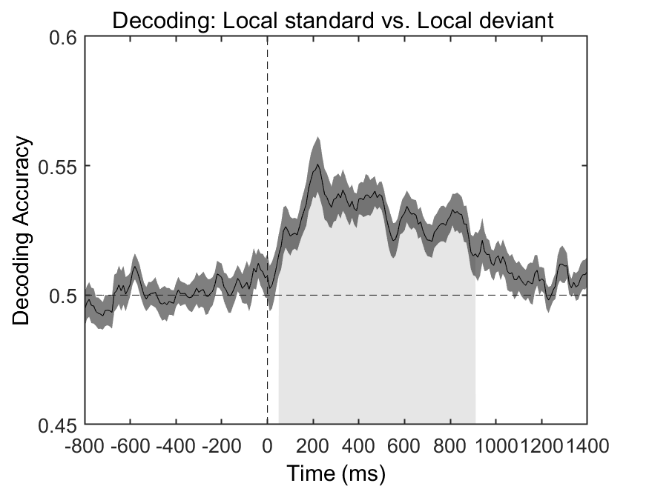
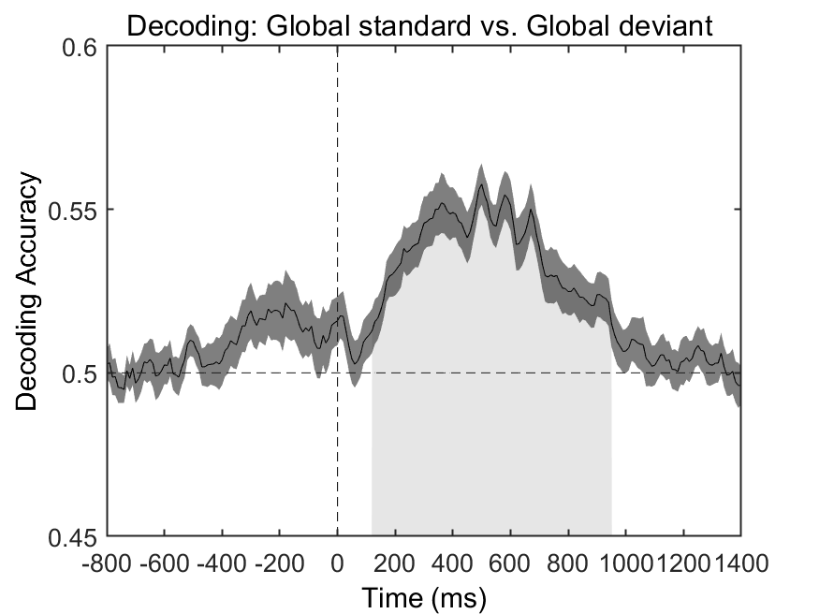
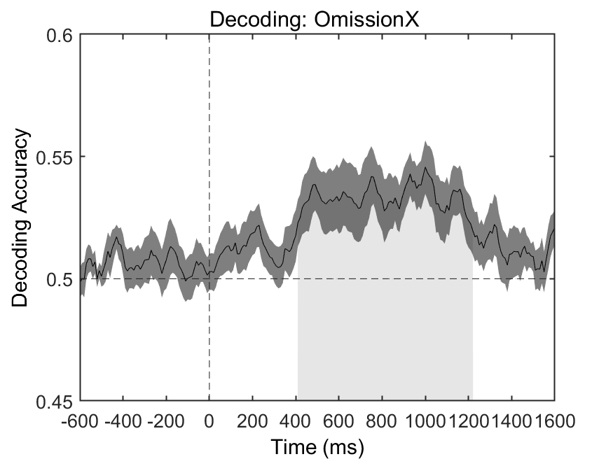
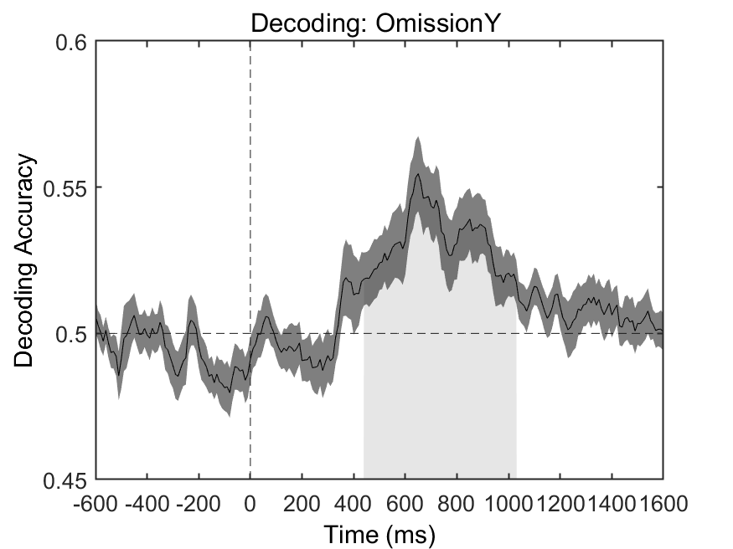
A
B
Figure 9. Decoding results for experiment 1
C
D

Slide 10
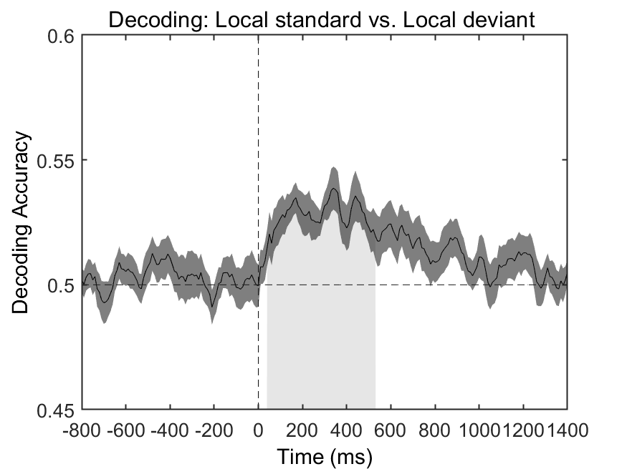
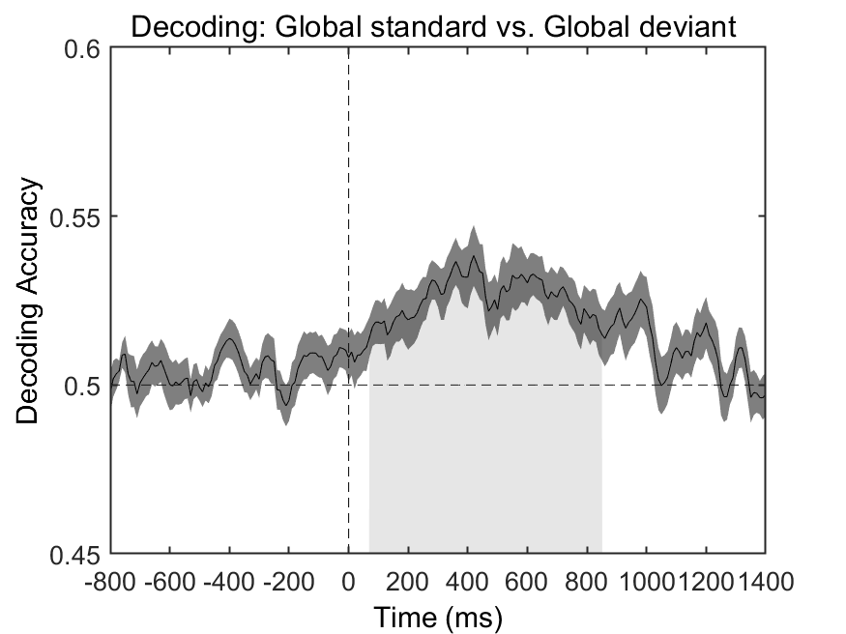
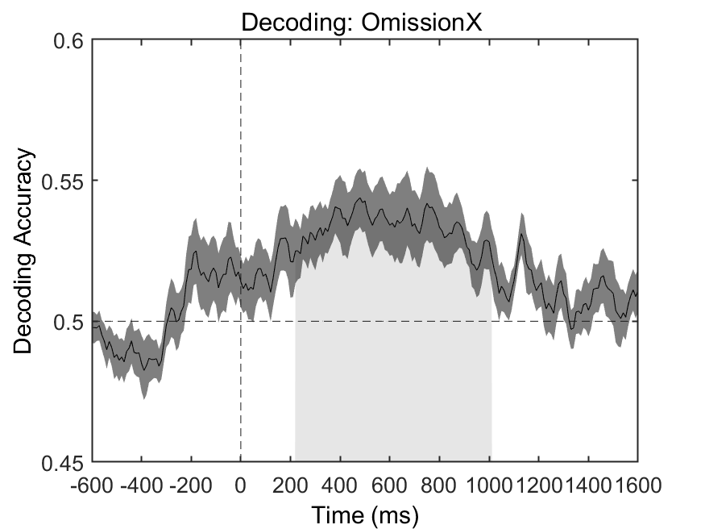
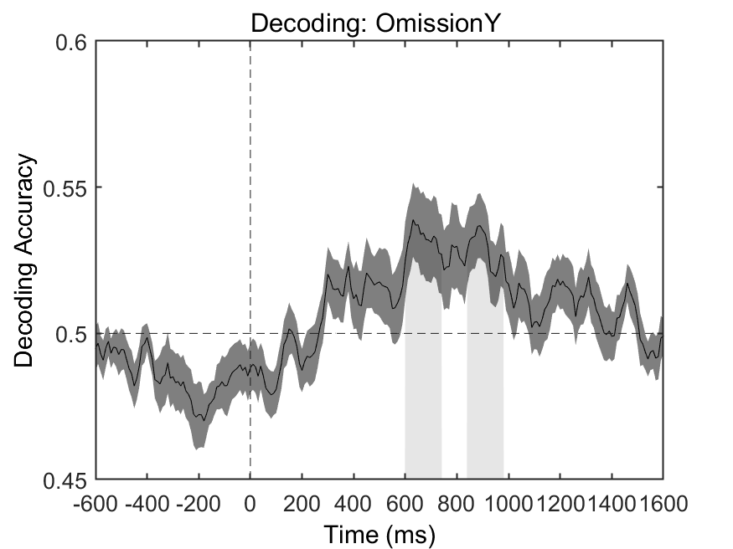
A
B
Figure 10. Decoding results for experiment 2
C
D

Slide 11
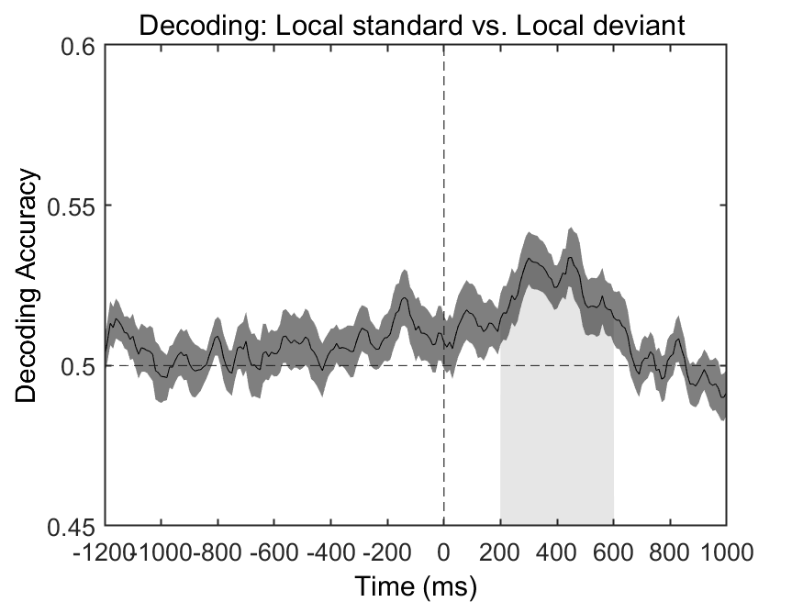
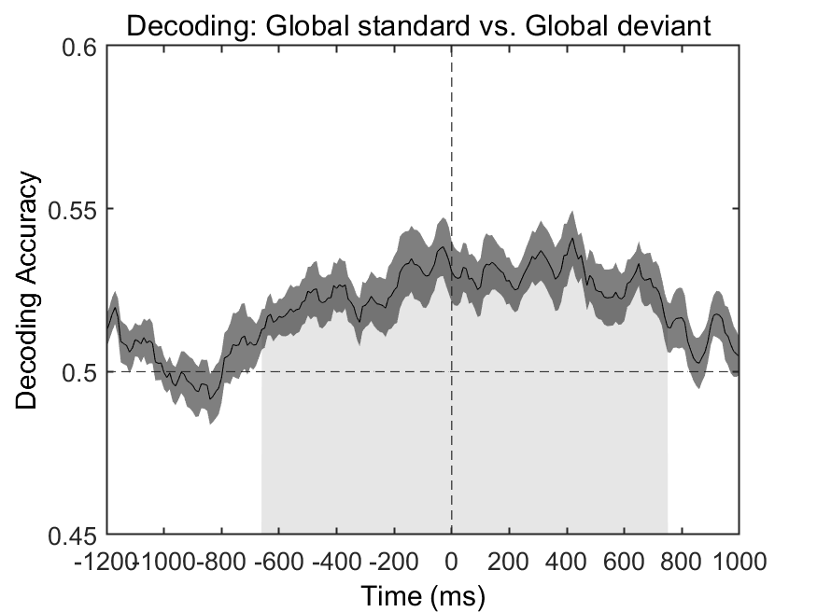
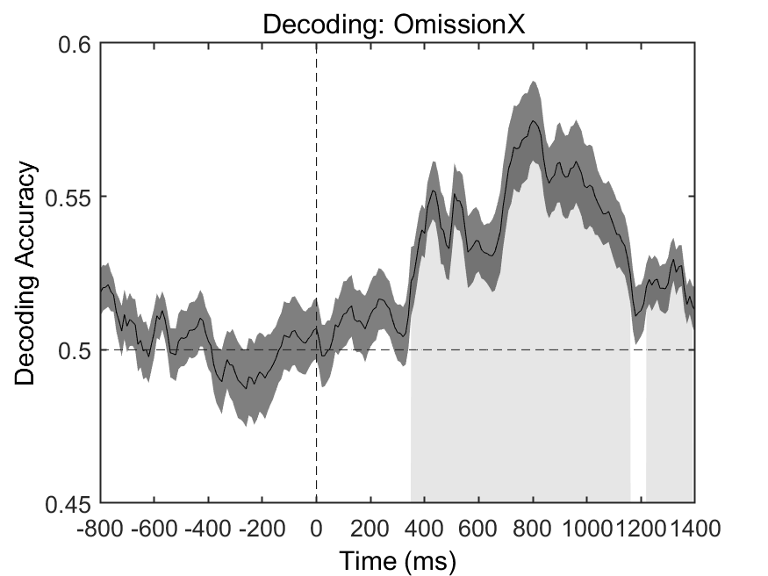
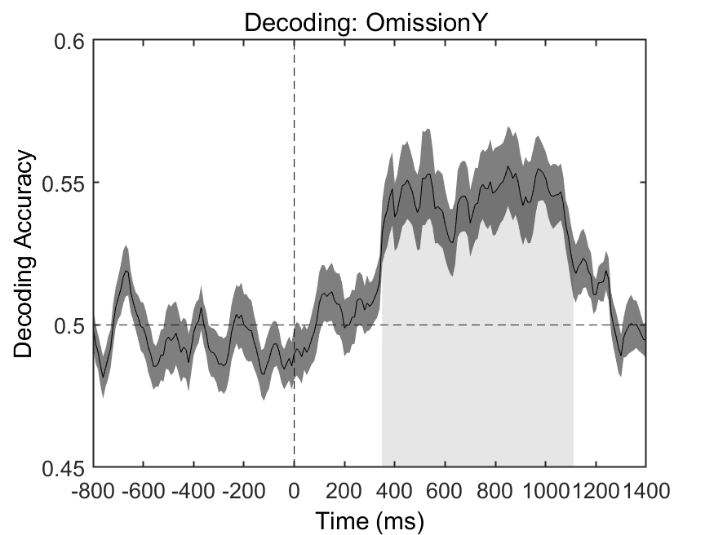
A
B
Figure 11. Decoding results for experiment 3
C
D

Slide 12

Figure 12. Spatial correlation matrix of beta values for four condition decoding across three experiments.

Slide 13




A
B
Figure 13. Pupil dilation as a marker for four kinds of deviant detections.
C
D

Slide 14




A
B
Figure 14. Cross Correlation between ERP difference and Pupil size difference in four condition comparisons
C
D

Slide 15




A
B
Figure 15. Cross Correlation between ERP difference and Pupil size difference in four condition comparisons
C
D

Slide 17

Figure 1. Illustrations of trial design and block design for experiment 1. The upper panel (A) illustrates each trial is either a 4-sound sequence which consists of four tones of 50ms long with gaps of 200ms between each tone, or a 3-sound sequence which contains three 50-ms long tones with 200ms long gaps. Intervals between trials are random selected between 1.5 second to 2 second. The down panel (B) shows the experiment involves both XXXX and XXXY task. XXXX task with deviant block is consisted of 75% standard trials (XXXX), 12.5% new frequency trials (X’X’X’X’ and 12.5% rule deviant trials (X’X’X’Y’); XXXX task with omission block is consisted of 75% standard trials (XXXX), 12.5% new frequency trials (X’X’X’X’ and 12.5% omission X trials (X’X’X’). In contrast, XXXY task with deviant block involves 75% standard trials (XXXY), 12.5% new frequency trials (X’X’X’Y’ and 12.5% rule deviant trials (X’X’X’X’); XXXX task with omission block involves 75% standard trials (XXXY), 12.5% new frequency trials (X’X’X’Y’) and 12.5% omission Y trials (X’X’X’). The orthogonal design of these experiments enable two level of regularities, standard versus deviant and local versus global.

Slide 18

Figure 2. Grand-averaged ERPs elicited by local and global comparison in experiment 1. The upper left panel (A): Local deviant trials elicit mismatch negativity (MMN) response compared local standard trials at Cz electrode. Gray-shaded area in the upper middle panel (B) indicates statistically significant time window (190-250ms) for this MMN response. The scalp topographic maps of t value upper right panel (C) confirms that MMN component during 190-250ms dominant in central area is related to local rule violation. The bottom left panel (D): Global deviant trials elicit P3b response compared global standard trials at Pz electrode. Gray-shaded area in the bottom middle panel (E) indicates statistically significant time window (220-900ms) for this P3b response. The scalp topographic maps of statistical difference in down right panel (F) shows significant P3b component related to global rule violation maximal around parietal cortex ranged from 220ms to 900ms.

Slide 19

Figure 3. Grand-averaged ERPs elicited by two kinds of omission comparisons in experiment 1. The upper left panel (A): Omission X trials elicit P3b response compared non-omission X trials at Pz electrode. Gray-shaded area in the upper middle panel (B) indicates statistically significant time window (600-1000ms) for this P3b response. The scalp topographic maps of t value upper right panel (C) confirms that P3b component during 600-1000ms dominant in parietal area. The bottom left panel (D): Omission Y trials elicit P3b response compared non-omission Y trials at Pz electrode. Gray-shaded area in the bottom middle panel (E) indicates statistically significant time window (220-900ms) for this P3b response. The scalp topographic maps of statistical difference in down right panel (F) shows significant P3b component maximal around parietal cortex ranged from 650ms to 1000ms.

Slide 20

Figure 4. Single-trial decoding results for experiment 1. The onset time of significant decoding performance was earlier in local comparison (A) compared to that of global comparison (B), indicated that local effect information was earlier available than global effect. Furthermore, the time when the peak in decoding performance occur also showed local effect was precede global effect. The onset time of significant decoding performance in Omission X comparison (C) and Omission Y comparison (D) were all later than that of local effect, but similar with global effect, which suggested that brain response to auditory omission may be not just predictive error, because they shared some common characteristics with global effect.

Slide 21
Figure 5. Temporal generalization results for experiment 1.

Slide 22
Figure 6. Spatial correlation matrix of t values for four condition comparisons of ERPs across three experiments. Conditions (1-3) correspond to local comparison in experiment 1, 2 and 3 respectively; Conditions (4-6) correspond to global comparison in experiment 1, 2 and 3 respectively; Conditions (7-9) correspond to omission X comparison in experiment 1, 2 and 3 respectively; Conditions (10-12) correspond to omission Y comparison in experiment 1, 2 and 3 respectively. High correlations of patterns of t values are found within and between global and omission X condition comparison across three experiments. However, high correlations of patterns of t values are only found within omission Y condition comparison across two auditory experiments.

Slide 23
Figure 7. Spatial correlation matrix of beta values for four condition decoding across three experiments.

Slide 24

Figure 8. Pupil dilation as a marker for four kinds of deviant detections in experiment 2. Significant difference of pupil size was observed between Local deviant versus Local standard (A) and Global deviant versus Global standard (B). The modulation of local effect on pupil size seemed relatively earlier than global effect. However, we observed different pupil response for omission x effect (C) and omission y effect (D). As for omission X, it showed obvious difference compared to no omission x trials. But there was no significant difference between Omission y trials and No omission y trials, suggesting that these two kinds of omission response may reflect different process.

Slide 25

Figure 9. Cross Correlation between ERP difference and Pupil size difference in four condition comparisons in experiment 2

